Slide 1

Regularization Optimized Models
Report by: Amit Kumar(DATA Analyst)

Slide 2
Rational Statement
Introduction
In this task, we address a real-world issue that Mr. John Hughes, a fisheries enthusiast, is facing in today's session. Mr. Hughes is trying to use the "FishWeight.csv" dataset, which has 159 observations and 6 variables, to develop an optimum model for forecasting fish weight. The accuracy of weight prediction is critical for fisheries management, and this dataset is a useful tool for studying fish behavior and health.
Problem Statement Predicting fish weight is an essential part of managing fisheries. Conventional regression models frequently perform poorly when handling anomalies and noisy data. Our goal is to improve fish weight prediction by using regularization models—LASSO, Ridge, and Elastic Net—to address this problem. Tukey's approach is the first step in our trip, as it ensures a cleaner dataset for modeling by removing outliers.
This presentation's goals are as follows:
Key Objectives:
Apply Tukey's approach to the FishWeight dataset to find and remove outliers.
Create and refine LASSO, Ridge and Elastic Net models to estimate fish weight.
To extract crucial information about the performance of the model, present and analyze key metrics such as Root Mean Squared Error (RMSE), Mean Absolute Error (MAE), and Adjusted R².
Choose the best model that Mr. John Hughes could use and suggest two tactical moves that would improve the model's usability and efficacy even further.
Goal: The goal of our journey is to provide Mr. Hughes with the information and resources necessary to make wise judgments in the field of fisheries, in addition to the ability to anticipate fish weight.

Slide 3
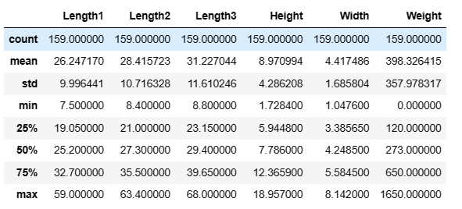

Dataset and Variables
Data Set is FishWeight.csv
The dataset has 159 observations and 6 variables:
Independent Variables
Length1 - vertical length in cm
Length2 - diagonal length in cm
Length3 - cross length in cm
Height - height in cm
Width - diagonal width in cm
Dependent Variable
Weight - weight of fish in grams(g)
Key Statistics using data.describe()

Slide 4
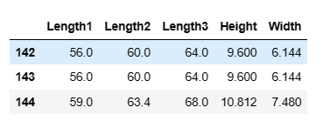
Outliers Removal Using Tukey Method
Identified Outliers
Three extreme data points were identified and eliminated from our dataset using Tukey's approach. The 'Length1', 'Length2', 'Length3', 'Height', and 'Width' variables contain these outliers, which have the ability to skew our predictive models. We guarantee a cleaner dataset by getting rid of them, which raises the accuracy of our fish weight estimates. For effective decision-making in fisheries management, this is an essential step.

Slide 5
Regularization Models
Lasso
Ridge
Elastic Net

Slide 6
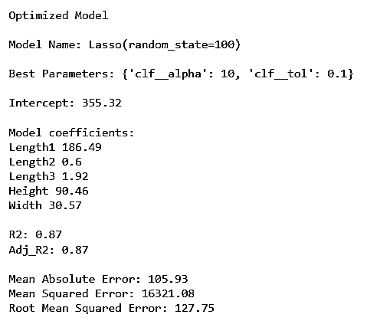
Optimized Lasso Model
Lasso's Adjusted R² (0.87) is marginally lower than Linear Regression's (0.90), suggesting a somewhat poorer model fit.
Lasso may not fit the data as well as Linear Regression, explaining a little less part of the variance in fish weight.
Compared to Linear Regression (96.65), Lasso displays a higher MAE (105.93), indicating fewer accurate predictions.
Lasso's forecasts generally show a little decrease in prediction accuracy as they diverge more from actual fish weights.
When comparing Lasso's RMSE (127.75) to Linear Regression's (116.31), Lasso's results show that the average magnitude of its prediction mistakes is higher.
Compared to Linear Regression, which has less variability, Lasso's predictions, on average, deviate from the true values.

Slide 7
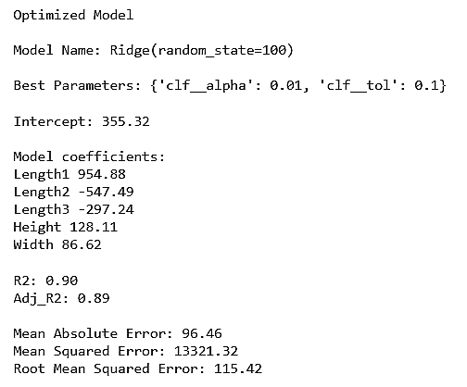
Optimized Ridge Model
Optimized Lasso Model
R2 adjusted:
Shows that 89% of the variation in fish weight can be explained by the model
considers the harmony between the explanatory power and model complexity.
MAE, or Mean Absolute Error:
The average forecast error is represented by an MAE of 96.46 grams.
Relatively close predictions to actual values are implied by lower MAE.
Root Mean Squared Error (RMSE):
The RMSE, or root mean square error, is 115.42 grams and indicates the average size of forecast errors.
Overall, fewer prediction errors are indicated by a lower RMSE.

Slide 8
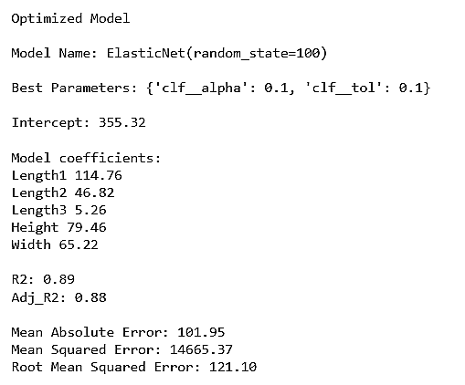
Optimized Elastic Net Model
R2 adjusted
shows that 88% of the variability in fish weight can be explained by the model.
considers the harmony between the explanatory power and model complexity.
MAE, or Mean Absolute Error
101.95 grams is the average prediction deviation (MAE).
When compared to the Ridge model, a higher MAE suggests somewhat less accurate predictions.
Root Mean Squared Error(RMSE)
An RMSE of 121.10 grams indicates how much forecast errors vary on average.
Comparing the RMSE to the Ridge model, a higher RMSE indicates somewhat greater overall prediction errors.

Slide 9
A Robust Choice for Fish Weight Prediction
RIDGE MODEL
Reasoning
With an R2 of 0.90, suggesting excellent explanatory power, and an Adjusted R2 of 0.89, taking model complexity into account, the Ridge model does well overall.
The forecasts are accurate with relatively modest mistakes, as seen by the Mean Absolute Error (MAE) of 96.46 grams and Strong Predictive Capability
Reliable and Consistent Predictions: The Ridge model's ability to reliably forecast fish weight is demonstrated by its strong R2, low MAE, and RMSE values. Our client Mr. Hughes needs this consistency to make wise decisions based on reliable model outputs.
In conclusion, the Ridge model not only predicts fish weight with a high degree of accuracy, but it also gives Mr. Hughes a thorough and insightful understanding of the variables affecting the forecasts. Because of its well-balanced performance characteristics, it is a reliable option for real-world uses.

Slide 10
The Next Actions to Enhance Usability
Scaling and Normalization of Features
The stability and convergence of the model can be improved by scaling and normalizing the input features. By using preprocessing approaches such as Standard Scaling, one can improve the robustness of the model by ensuring that all features contribute consistently.
Continuous Monitoring and Updating
Track the model's performance over time as fresh data becomes available on a regular basis. Establish a mechanism for updating or retraining the model in order to keep it current and efficient in identifying any changing trends in the factors that determine fish weight. This guarantees that the model remains valid and accurate in changing circumstances.

Slide 11
Thank You

